Slide 1
Final Report
Clustering station areas in Tokyo based on venues information

Slide 2
Agenda
Introduction/Business Problem
Data
Methodology
Results
Discussion
Conclusion

Slide 3
Introduction
Business Problem: Clustering areas in Tokyo based on train stations
Background: A Real Estate Agent would like to cluster areas in Tokyo so they can make good suggestions to their customers based on their needs.
Goal of this project: To cluster

Slide 4
Data
List of stations in Tokyo - We can get it from the following Wikipedia pages:
https://en.wikipedia.org/wiki/Category:Railway_stations_in_Tokyo
https://en.wikipedia.org/w/index.php?title=Category:Railway_stations_in_Tokyo&pagefrom=Kasai+Station#mw-pages
https://en.wikipedia.org/w/index.php?title=Category:Railway_stations_in_Tokyo&pagefrom=Okachimachi+Station#mw-pages
https://en.wikipedia.org/w/index.php?title=Category:Railway_stations_in_Tokyo&pagefrom=Tsukishima+Station#mw-pages
geopy to get latitude and longitude information of each area(Google API information cannot be used in this project, because of the user policy)
Venue information for each area through FourSquare API

Slide 5
Methodology
I used the following research methodology:
Getting venue information of every station area in Tokyo, from FourSquare API
Counting the number of categories of the venues
Applying K-Means Clustering to cluster the areas based on venue information.

Slide 6
Results
Using our model, we could cluster Tokyo areas into the following groups:
- Cluster Label 0: Suburb areas for living
- Cluster Label 1: Central eating areas
- Cluster Label 2: Central areas to hang out
- Cluster Label 3: Drinking areas¶
- Cluster Label 4: Places for living in middle-central areas
- Cluster Label 5: Places for living in central areas
- Cluster Label 6: Countryside areas

Slide 7
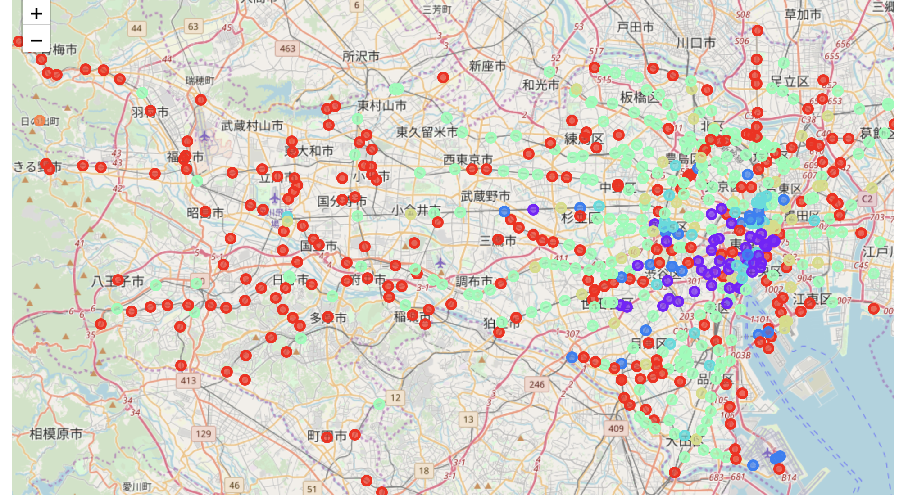







Results: Map
Cluster Label 0
Cluster Label 1
Cluster Label 2
Cluster Label 3
Cluster Label 4
Cluster Label 5
Cluster Label 6

Slide 8
Discussion - Findings
As we discussed in the results, we could cluster tokyo areas into 6 groups.
Even Central areas, places for hanging out, drinking, eating and living are different.
Based on our findings, Real Estate Agent can make a suggestion to their customer.

Slide 9
Discussion - Further Research
However, we could not cluster the areas considering relations between categories of venues. For example, Ramen Restaurants and Japanese Restaurants seem to be closely related, but my model clustered the areas without considering these kind of relations.
Therefore, with considering relations of categories, we can further cluster the areas based on venue category information. We may be able to do this using Natural Language Processing.

Slide 10
Conclusion
The below is the conclusion:
We can cluster station areas in Tokyo into 6 groups.
Central areas can be grouped as eating, living, hanging out and drinking areas
For further research, it would be good if we consider relations between venue categories.

